Slide 1
Intelligent Digital Signage-based Advertisement Scheduling Algorithms for Impression Maximization Problem
2016.09.02
吳昊東

Slide 2
Outline
Introduction
Related work
Problem statement
Methods
Experiments
Conclusion

Slide 3
Outline
Introduction
Related work
Problem statement
Methods
Experiments
Conclusion

Slide 4
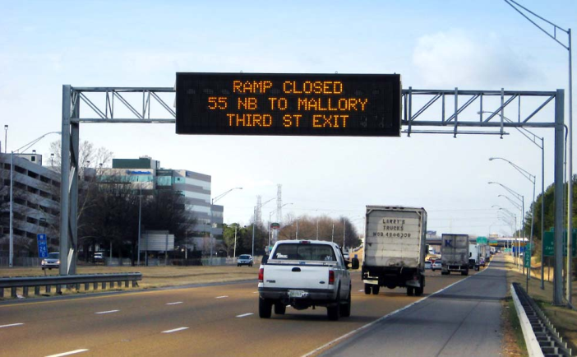
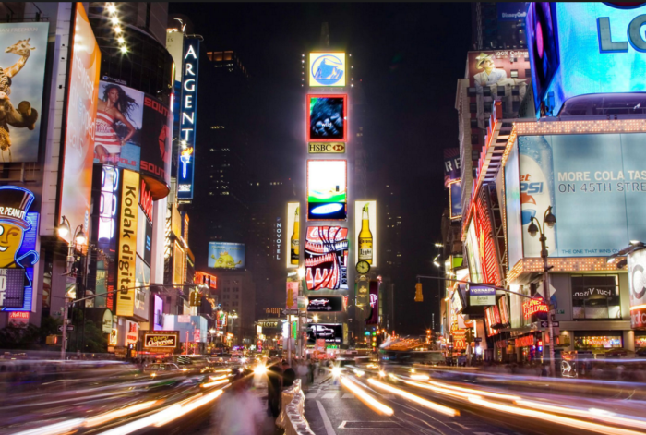
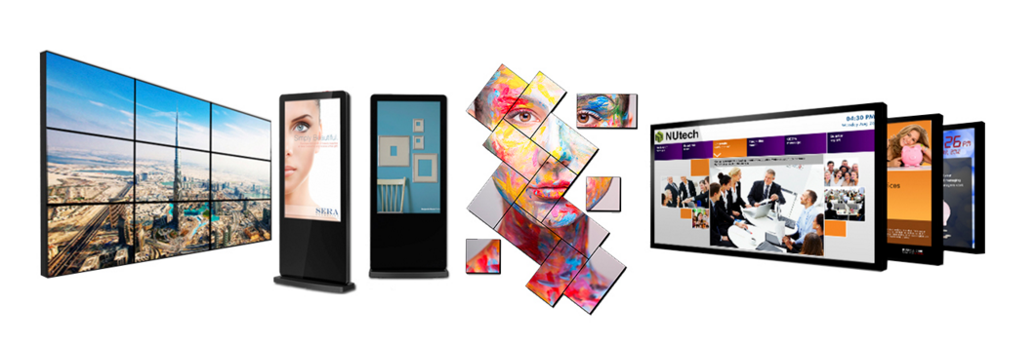
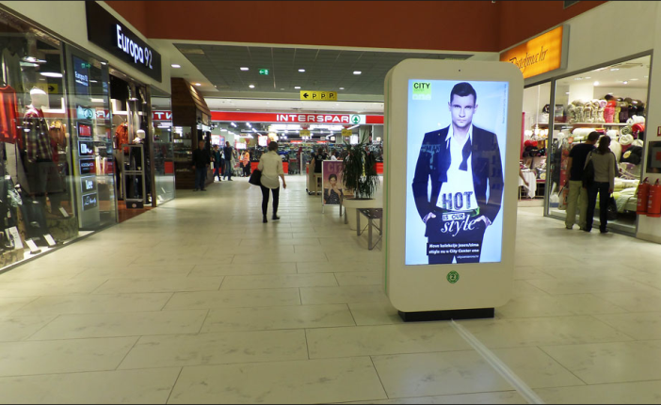
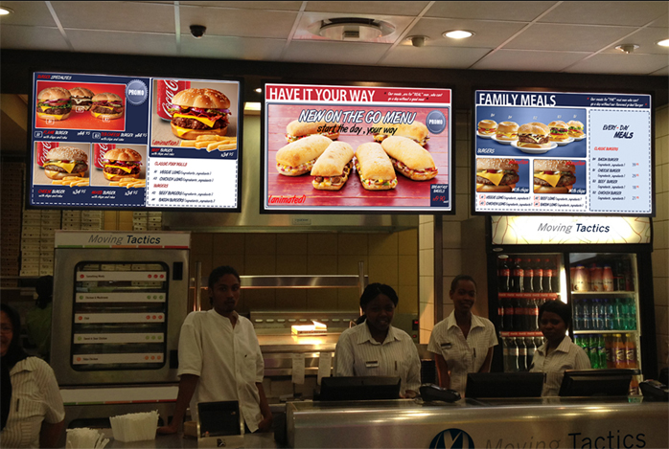
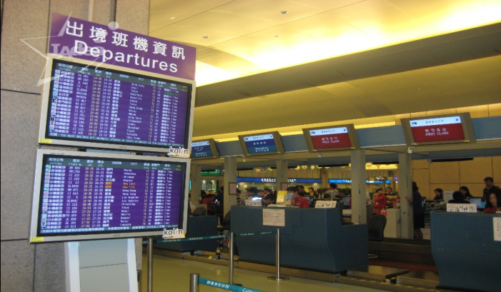
Background
What is digital signage?
Digital signage-based advertising is getting more popular!
Notes:
1，什麼是電子看板？
技術：LED，LCD，投影
內容： images，video，streaming media，information（注意：不一定是播放廣告）
地點：路上，街邊，商場，餐廳，機場等
2，基於電子看板的廣告行銷的流行
蘊含巨大商機！

Slide 5
Scheduling For Digital Signage-based Advertising
Why scheduling?
Many advertisements!
Existing scheduling methods?
Round Robin
Challenges?
Different due day
Different impression request
RR cannot solve this problem
Notes:
1,為什麼要排程?
▪ 廣告很多(一個廣告不需要排)
2,現狀(Existing Solution)
▪ 但目前對基於電子看板的廣告排程問題的研究極少,
3,Challenge/ Requirement on demand (problem and challenge)
▪ 廣告需要的播放需求不同(播放期限,觀看人數)
▪ Naïve solution(Round Robin)無法解決問題

Slide 6
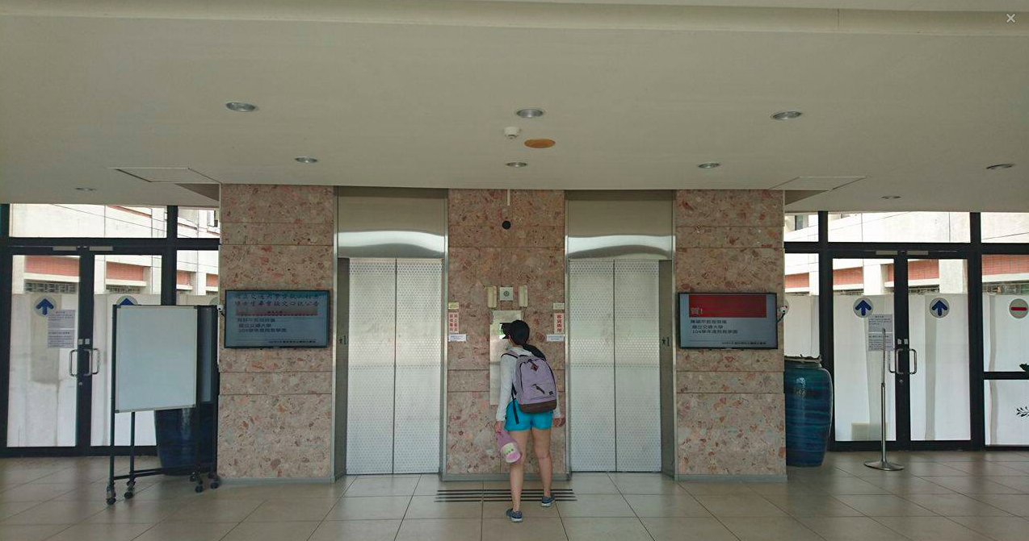
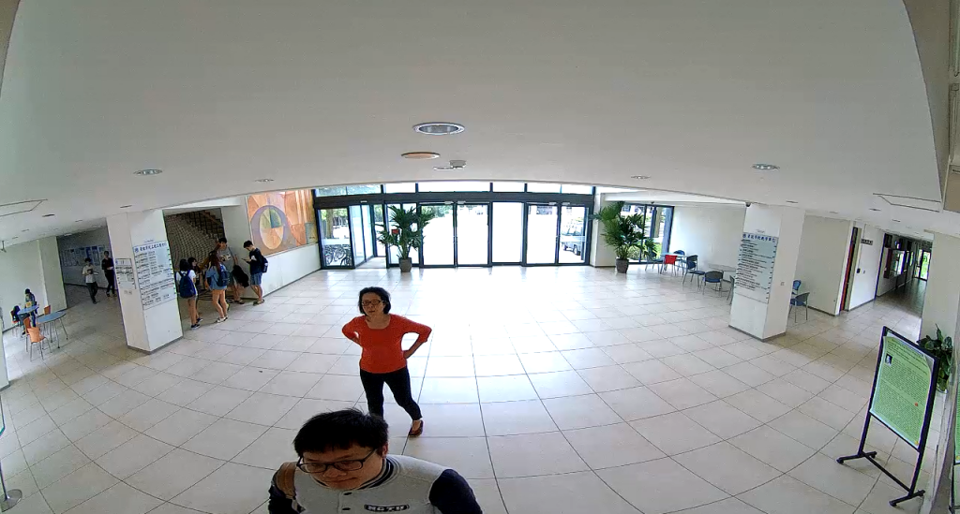
Make It More Intelligent
Why Intelligence?
More effective
How to make it?
Information of Ads
Features(Category, Media…)
Information of audience
# of people
Watch or not
Age, Gender
Camera
Ad (Features)
# of people: 2
Notes:
1，為什麼要智能?(why)
▪ 有效果,不做白工,
2，如何讓 digital signage-based advertising 具有智能?(How)
▪ 廣告模型(廣告 feature,吸引力)
▪ 人流資訊(人數,性別,年齡)

Slide 7
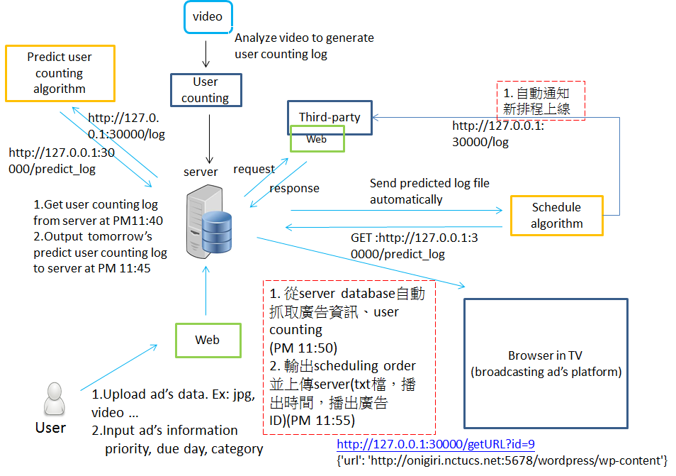
Our Work

Slide 8
Outline
Introduction
Related work
Problem statement
Methods
Experiments
Conclusion

Slide 9
Related Works
Intelligent advertising for digital signage
P. Tian, A. V. Sanjay, K. Chiranjeevi, and S. M. Malik, “Intelligent advertising framework for digital signage,” in Proceedings of the 2012 ACM SIGKDD international conference on Knowledge Discovery and Data mining. ACM, 2012, pp. 1532–1535.
J. Muller, J. Exeler, M. Buzeck, and A. Kruger, “Reflective signs: digital signs that adapt to audience attention,” in Proceedings of the 2009 international conference on Pervasive Computing, 2009, pp. 17–24.
Scheduling
Abraham S, Peter BG, Greg G. Operating system concepts: Process scheduling. 2010, 8th edition.
C. L. Liu, J. W. Layland, “Scheduling algorithms for multiprogramming in a hard-real-time environment,” in JACM, 1973, pp. 46-61.

Slide 10
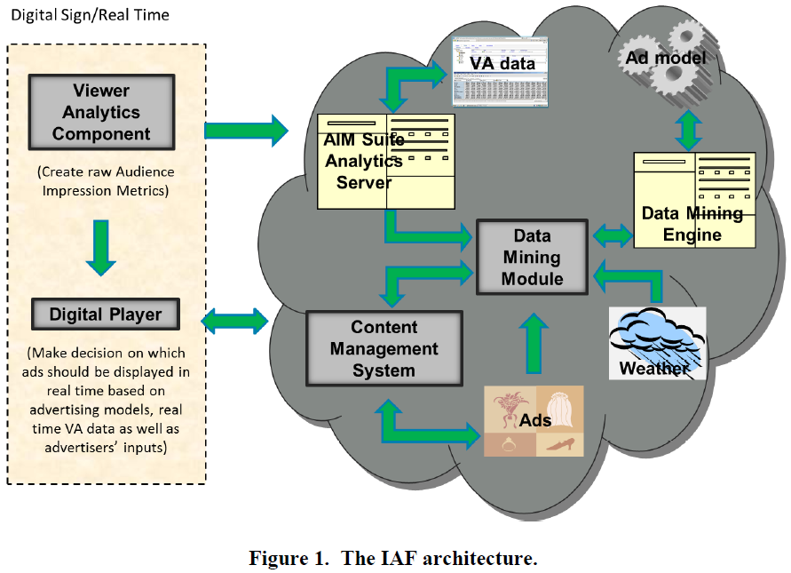
Related Work1: IAF
Data Mining
Viewer Analytics
Ad Content
Notes:
IAF: Intelligent Advertising Framework
IAF can provide advertisers and retailers with intelligence to show the right ads to right audience in right location at right time.
(Then explain the elements in the picture…)

Slide 11
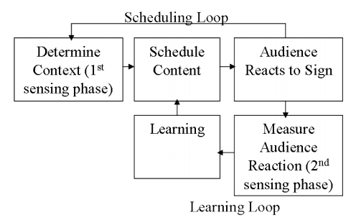
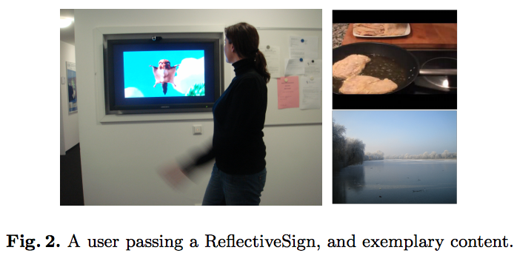
Related Work2: Reflective Sign

Slide 12
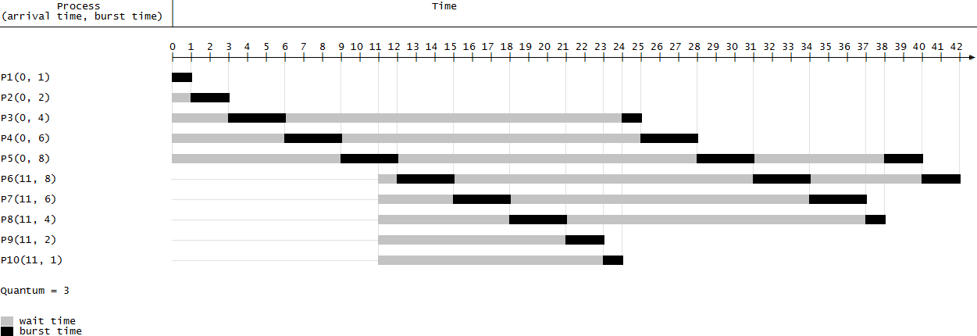
Related Work3: Process Scheduling
First-Come, First-Served (FCFS)
Shortest-Job-First (SJF)
Shortest-Remaining-Time-First
Priority
Round Robin (RR)
Notes:
CPU process 時間單位：秒
AD 播放時間單位：天
所以更多是概念／原則的應用

Slide 13
Comparison of related works
 | Impression maximization problem | Scheduling algorithm | Intelligence
 |  |  | Viewer Analytics | Advertising model
Intelligent advertising framework | X | X | O | O
Reflective sign | X | O | O | X
Our work | O | O | O | O
Notes:
IMP：面向廣告商，盡量達到IR和DD的要求
兩篇related work都是面向用戶，進行目標行銷

Slide 14
Outline
Introduction
Related Work
Problem statement
Methods
Experiments
Conclusion

Slide 15
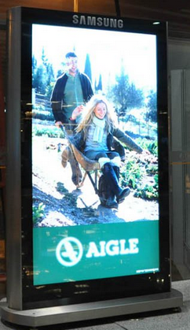

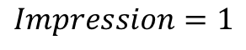
Impression Maximization Problem
Impression:
Each time an Ad is fetched and watched by one person, it is counted as one impression.
Impression Maximization (IM):
Given N Ads, each Ad has its Impression Request (IR) and Due Day (DD), design a Ads playing schedule for a day to evenly maximize the impression those Ads can get.
$$Impression=1$$
Notes:
定義增加 evenly

Slide 16
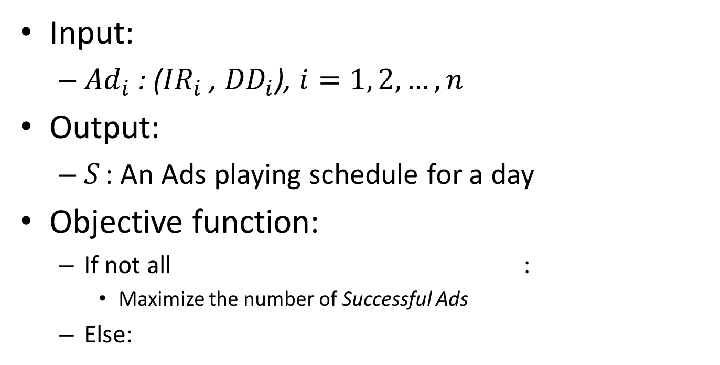
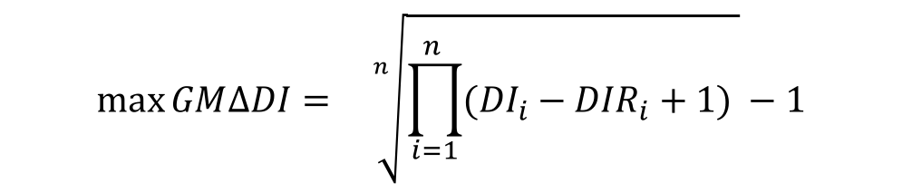
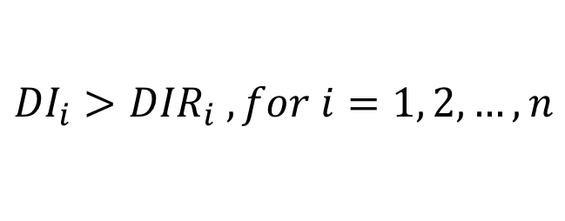
Problem Definition
Input:
${Ad}_{i}$ : (${IR}_{i}$ , ${DD}_{i}$), $i=1, 2, …, n$
Output:
$S_{ }$: An Ads playing schedule for a day
Objective function:
If not all :
Maximize the number of Successful Ads
Else:
$${DI}_{i}>{DIR}_{i} , for i=1, 2, …, n$$
$$\max{GM∆DI}={\underset{ }{}{\sqrt[n]{{\prod_{i=1}^{n_{ }}{({DI}_{i}−{DIR}_{i}}+1)}^{ }}−1}}$$
Notes:
要先介紹DI和DIR！！
為什麼是for a day？(IM的定義就是這樣：一天為一個排程和更新週期)
為什麼是uniform distribution？（因為我們不知道他是／需要哪種distribution，所以選擇最簡單最直覺的uniform～）
Objective function條件判別？（怎樣知道DI（實際的impression）？Video log＋工人智慧（目前））
第一種情況下，成功的廣告依然IM？(不必了，已經將minimize failed ads變成maximize successful ads了！)

Slide 17
Outline
Introduction
Related Work
Problem statement
Methods
Experiments
Conclusion

Slide 18
Framework
New Ads
(IR, DD)
AD Scheduler
One-by-one
or
AD-pair
Historical Data
Training
AD-model
+
SOP-model
New Ads
(IR, DD)
WPR
Scheduling Result
Notes:
data source

Slide 19
AD-model
AD-model construction
Feature extraction
New Ads
Features
New Ads
New Ads
WPR
AD-model
Training
Historical data
Ads
Features
WPR
Audiences
# of people

Slide 20
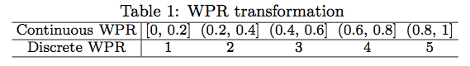
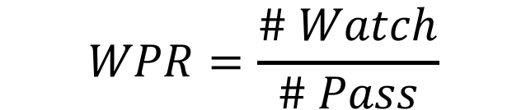
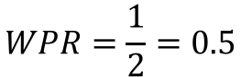
Watch Pass Rate
WPR
WPR represents the attraction level of an Ad.
Discretization
Divided into k grades
Set k = 5
How to use it?
$$WPR=\frac{\# Watch}{\# Pass}$$
$$WPR=\frac{1}{2}=0.5$$
The higher WPR, the less playing time.
Notes:
WPR為什麼要分5等？實驗證明？

Slide 21

Feature Extraction
What features of an Ad will influence its WPR?
Category, Media-type, Color, Size,
Text (Size/number/color of words, language),
Originality, Freshness …
We choose 5 features for our experiments.
Suitable for digital signage-based AD
Easy to measure
{
AD-ID: 0
Category: Public service
Sub-category: Shark fin
Media: Picture
Text-percentage: 0.2
Color-scheme: White
}
Notes:
沒有找到features of Ad的相關文獻。。。

Slide 22
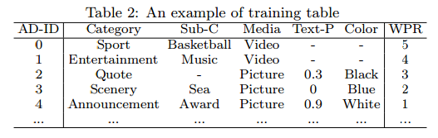
Training and Predicting
AD-model
Features
WPR
Notes:
real data（放在實驗部分？）

Slide 23
AD Scheduler
AD Scheduler
One-by-one
D3 (Due Day Driven)
DDIR (DD and IR driven)
DIW (DD, IR and WPR driven)
New Ads
(IR, DD)
WPR
Scheduling Result
or
AD-pair
PBAP (Probability-based AD-Pair)
PPSAP (Proportion-based Slicing AD-Pair)
PPSAPA (Proportion-based Slicing AD-Pair with Attraction)
+
SOP-model

Slide 24
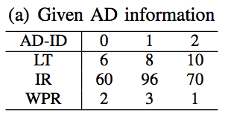
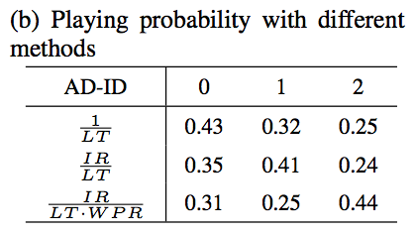
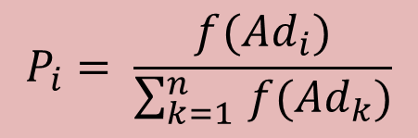
Playing Probability
$$P_{i}= \frac{f({Ad}_{i})}{\sum_{k=1 }^{n}{f({Ad}_{k})}}$$
Notes:
方法的進化（套路）
不同方法的結果
先不管播放重複的廣告（下一頁再說）

Slide 25
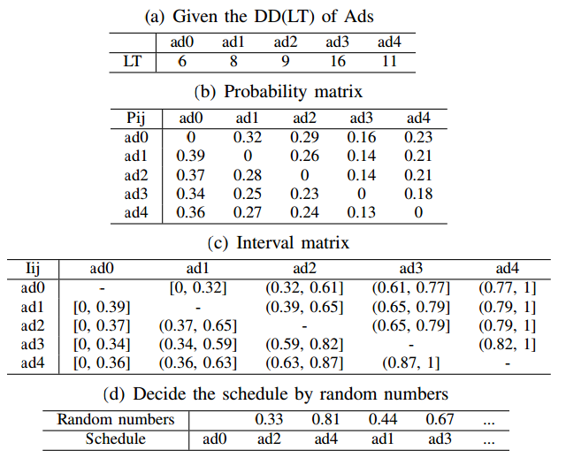
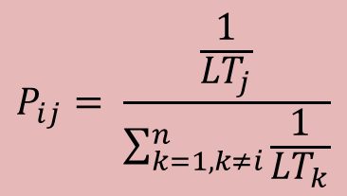
An Example of D3
$$P_{ij}= \frac{\frac{1}{{LT}_{j}}}{\sum_{k=1, k≠i}^{n}{\frac{1}{{LT}_{k}}}}$$

Slide 26
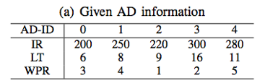
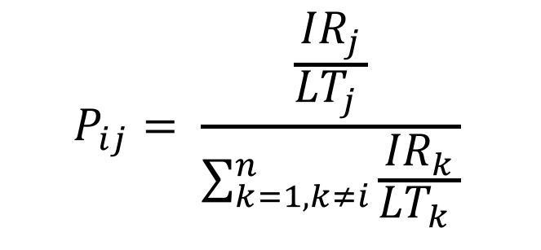
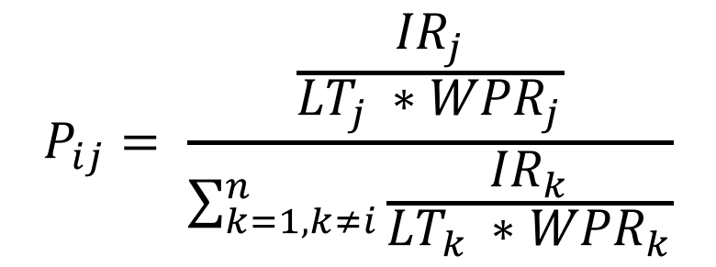
DDIR and DIW
$$P_{ij}= \frac{\frac{{IR}_{j}}{{{LT}_{j}}^{ }}}{\sum_{k=1, k≠i}^{n}{\frac{{IR}_{k}}{{{LT}_{k}}^{ }}}}$$
$$P_{ij}= \frac{\frac{{IR}_{j}}{{{LT}_{j}}^{ }∗{WPR}_{j}}}{\sum_{k=1,k≠i}^{n}{\frac{{IR}_{k}}{{{LT}_{k}}^{ }∗{WPR}_{k}}}}$$
Notes:
DDIR: 說明IR的影響
DIW：說明WPR的影響

Slide 27
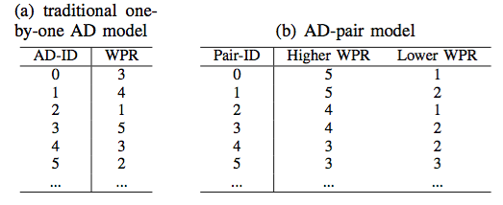
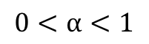
AD-pair Model
$$∆{WPR}_{l}=α\left({WPR}_{h}−{WPR}_{l}\right),$$
$$0<α<1$$
Notes:
How WPR of weak Ads be lifted???

Slide 28
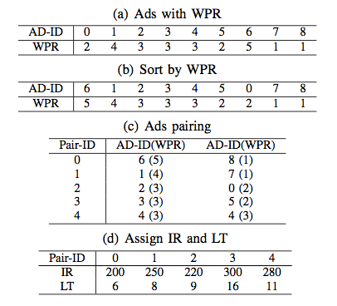
Probability-based AD-pair Scheduling
DDIR
Notes:
單數配對問題！？
問題是：如何assign IR和LT？
目前是用弱廣告的；
可以試試用平均值／強廣告的／更複雜
P1 和 P2 難免有差別，但配對后要用同一個新的 P 來取代，
就像（結婚的例子：相同價值觀 會更幸福。）
所以提出下面的slicing的方法！

Slide 29
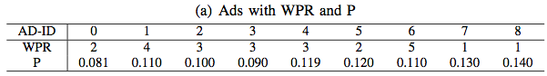
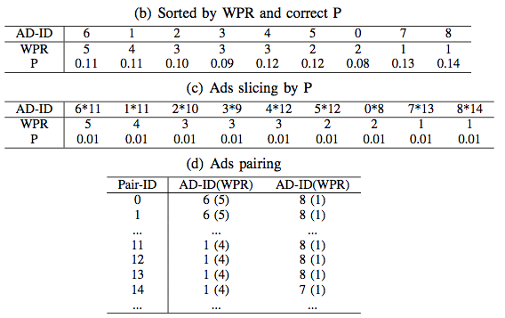
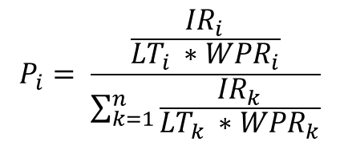
Proportion-based Slicing AD-pair Scheduling
$$P_{i}= \frac{\frac{{IR}_{i}}{{{LT}_{i}}^{ }∗{WPR}_{i}}}{\sum_{k=1}^{n}{\frac{{IR}_{k}}{{{LT}_{k}}^{ }∗{WPR}_{k}}}}$$
Shuffle
RR
Notes:
補充Paring後是用round robin的方法

Slide 30
Proportion-based Slicing AD-pair with Attractions Scheduling
What is Attractions?
When the Ads pool doesn’t have enough strong Ads, we actively add some interesting content into the pool as strong Ads. We call them “Attractions”, and their WPR is 5!
Pros and Cons
Pros: Attractions can improve Ads’ impression individually and globally.
Cons: Attractions occupy time.
Notes:
Explain “improve Ads’ impression individually and globally”

Slide 31
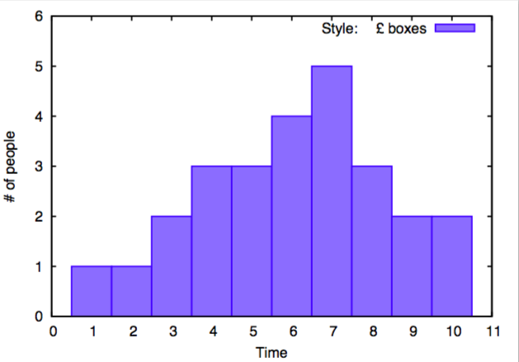
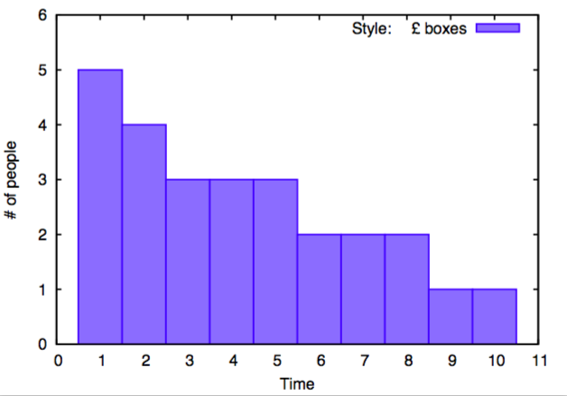
Scheduling with SOP-model
A0
A1
A2
A3
A4
A5
A6
A7
A8
A9
Sorting
A0
Restoring
Filling Ads
A1
A2
A3
A4
A5
A6
A7
A8
A9
Notes:
講清楚x，y軸
（x軸是time slot，不是小時）

Slide 32
Outline
Introduction
Related Work
Problem statement
Methods
Experiments
Conclusion

Slide 33
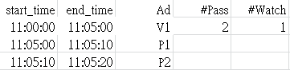
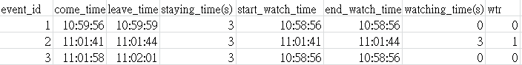
Datasets of AD-model Experiments
Real data:
Content:
Video log
Play log
Time:
2016.4.27 ~ 2016.5.3 (Wed ~ Tue)
11:00 ~ 13:00
Play log
Video log
Notes:
廣告數目（分類）
Feature distribution（數目；平均WPR）
data筆數(播放的；實際有人的)。。。
Synthetic data模擬？（新增）

Slide 34
Datasets of AD-model Experiments(Cont.)
Media
Category
Color-scheme
Category (10 types * 3 Ads)
Ad (Public Service)
Animal, Architeture
College Activity (People)
Comics, Living, Painting
Plant, Quote, Scenary
# of Ads
WPR
Text-percentage
% of playing time

Slide 35
WPR Distribution of Different Features
Media
Category
Color-scheme
Text-percentage
Notes:
PS：原本種類是AD（公益廣告）
ppl: 原本種類是College（學院活動）

Slide 36
Accuracy of AD-model
Training data: 56
Testing data: 56
Training data: 4.27 ~ 5.2
Testing data: 5.3
AD | # of Pass | # of Watch | WPR
ad1 | 3 | 1 | 0.333
ad2 | 4 | 2 | 0.5
ad1 | 5 | 3 | 0.6
ad2 | 4 | 2 | 0.5
ad2 | 3 | 1 | 0.33
Training data: 1048
Testing data: 56
Aggregation
AD | # of Pass | # of Watch | WPR
ad1 | 8 | 4 | 0.5
ad2 | 11 | 5 | 0.455
Notes:
distribution of features
distribution of playing time of different types of ads

Slide 37
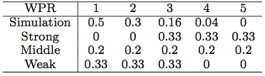
Datasets of Scheduling Experiments
Synthetic data:
4 kinds of AD datasets:
IR and LT:
Simulation: IR=[200, 400], DIR=[2, 10]
Others: IR=[200, 400], DIR=[10, 20]
SOP-model:
Use 2015.12. 1’s data as the predicted data.

Slide 38
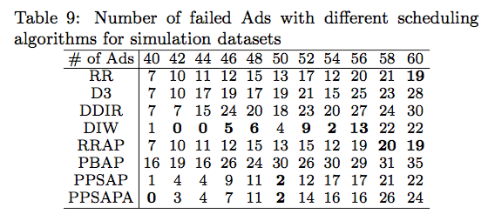
Simulation Scheduling Experiment

Slide 39
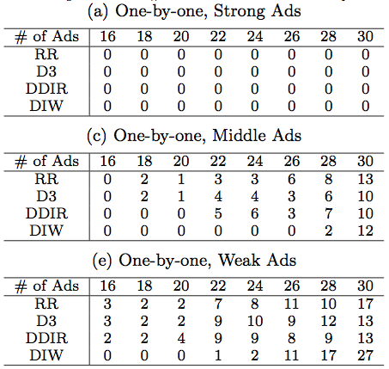
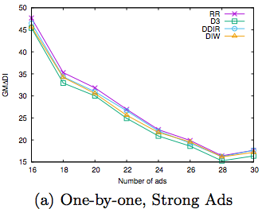
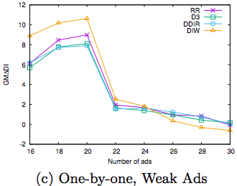
Comparison of One-By-One AD Scheduling Algorithms

Slide 40
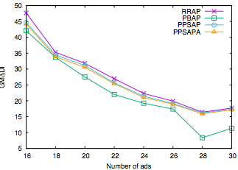
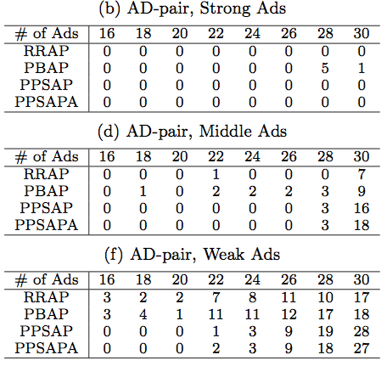
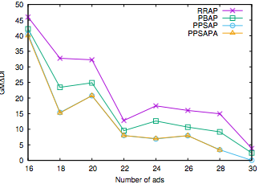
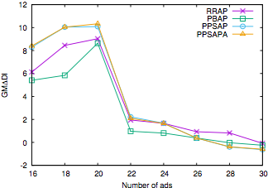
Comparison of AD-pair Scheduling Algorithms

Slide 41
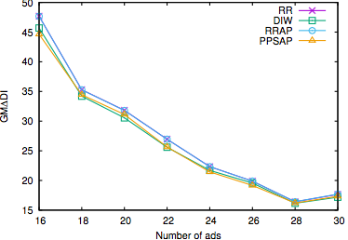



Comparison of One-By-One AD Scheduling and AD-pair Scheduling
Notes:
配對的基礎是有強有弱，
所以主要看middle Ads

Slide 42
Scheduling Experiments Analysis
Method |  | Request
 |  | High | Low
WPR | Strong | DIW | RR
 | Middle | PPSAP | RRAP
 | Weak | DIW/PPSAPA | RR/PPSAPA
Request
High request means it cannot make all Ads successful using RR.
(Low request the opposite.)
WPR
Strong: Average WPR >= 4
Middle: 2 < Average WPR < 4
Weak: Average WPR <= 2

Slide 43




Verification of “The Strong-Weak Effect”
:20
:30
:40
:50
:00
29
24
19
15
10
12
Notes:
先驗證圖片是強廣告，公告是弱廣告
才有強弱效應的驗證。
（上一頁顯示圖片與公告的強弱差別不明顯，所以這裡的強弱效應也不明顯。但是！還是證明這個效應是存在的！！！）

Slide 44



Scheduling Demo
Demo

Slide 45
Outline
Introduction
Related Work
Problem statement
Methods
Experiments
Conclusion

Slide 46
Conclusion
Formulate the impression maximization problem
Build the AD-model to help scheduling
Propose probability-based scheduling methods
and AD-pair scheduling methods
Propose the "Attractions" method
Conduct experiments on real and synthetic datasets,
and the results show that the proposed models are effective.
Notes:
字太多

Slide 47
Appendix

Slide 48


Training Data

Slide 49

Video Log

Slide 50


Ads Play Log

Slide 51


